Slide 1
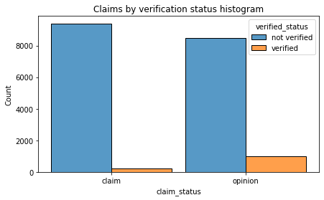
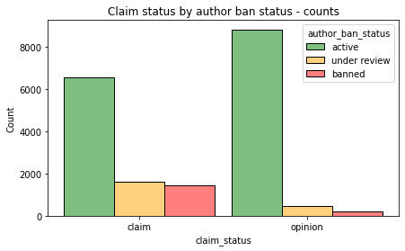
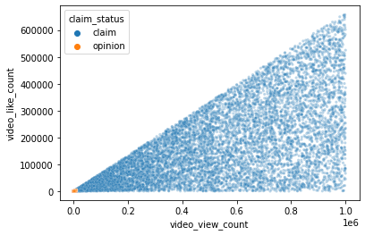
Executive Summary
TikTok Claims Classification Project – Exploratory Data Analysis (EDA)
UNDERSTANDING THE DATA
The TikTok data team seeks to develop a machine learning model to assist in the classification of claims for user submissions. To begin, the data team needed to conduct exploratory data analysis and create required visualizations.
Many of the count variables have outliers at the high end of the distribution. They have very large standard deviations and maximum values that are very high compared to their quartile values.
The data team performed exploratory data analysis and prepared visualizations on key variables.
Given the ask for a classification of user claims, the data team looked at the counts of claims and opinions in order to understand the count of each type of video content.
There are far fewer verified users than unverified users, but if a user *is* verified, they are much more likely to post opinions.
The impact of the exploratory data analysis is evident. The data team identified two important variables to consider. Video_view_count and video_share_count are important factors to consider for future prediction models.
For both claims and opinions, there are many more active authors than non-active authors; however, the proportion of active authors is greater for opinion videos than for claim videos. Authors who post claim videos are more likely to come under review and/or get banned.
Claim videos have much greater social media engagement than opinion videos
In the future, the team will need to decide how to handle outliers, which exist in almost every count variable
Over 200 null values were found in 7 different columns. Future modeling should consider the null values to avoid making insights that would assume complete data.

